Slide 1
SURGE Design Presentation:
The Academic

Slide 2
Game Design: Game Design
Current events prove that some members of society lack empathy, perspective taking, and intercultural agility.
Education can fix this. How do we engage students with an intrinsically serious and uncomfortable topic?
Gamification can make such topics more approachable.

Slide 3
Game Design: CONTENT
Using the SURGE 2020 grant, we had a large team of researchers and interviewers
They isolated important parts of history and saved them in an archive as “GEMS”
Part of the archive indicated how engaging the gem was, what characters were involved, and when it occured

Slide 4
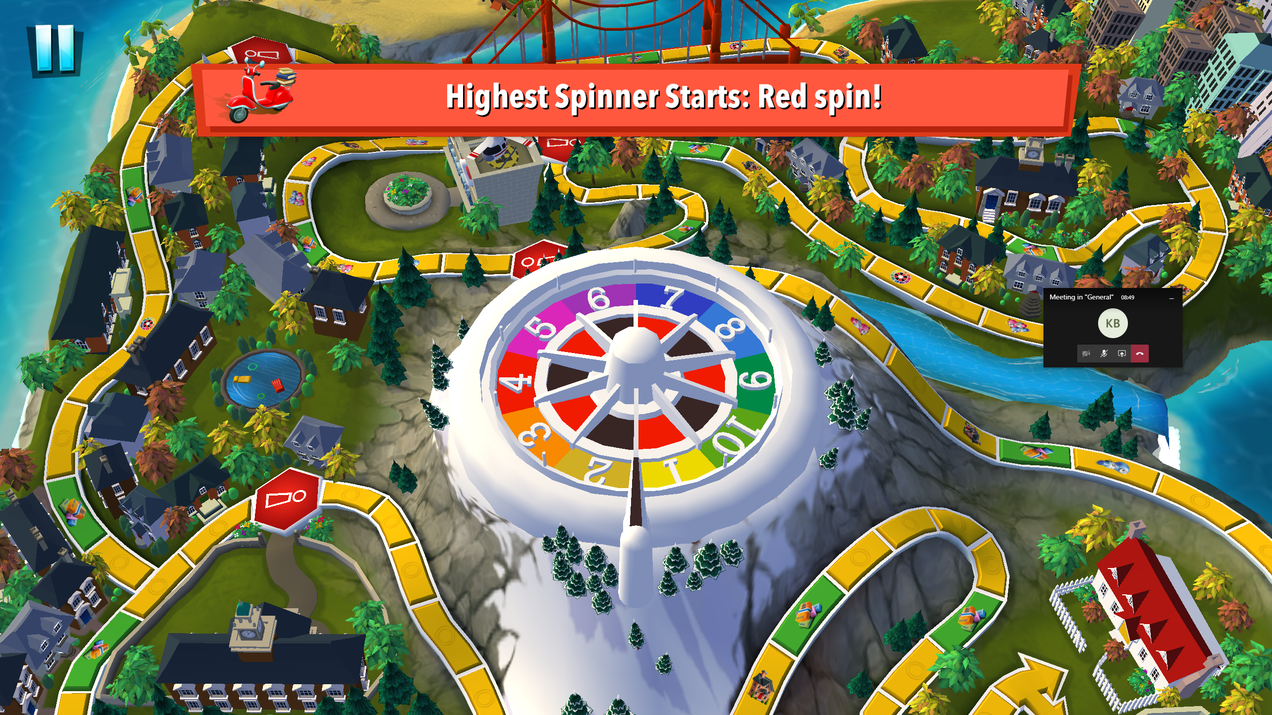
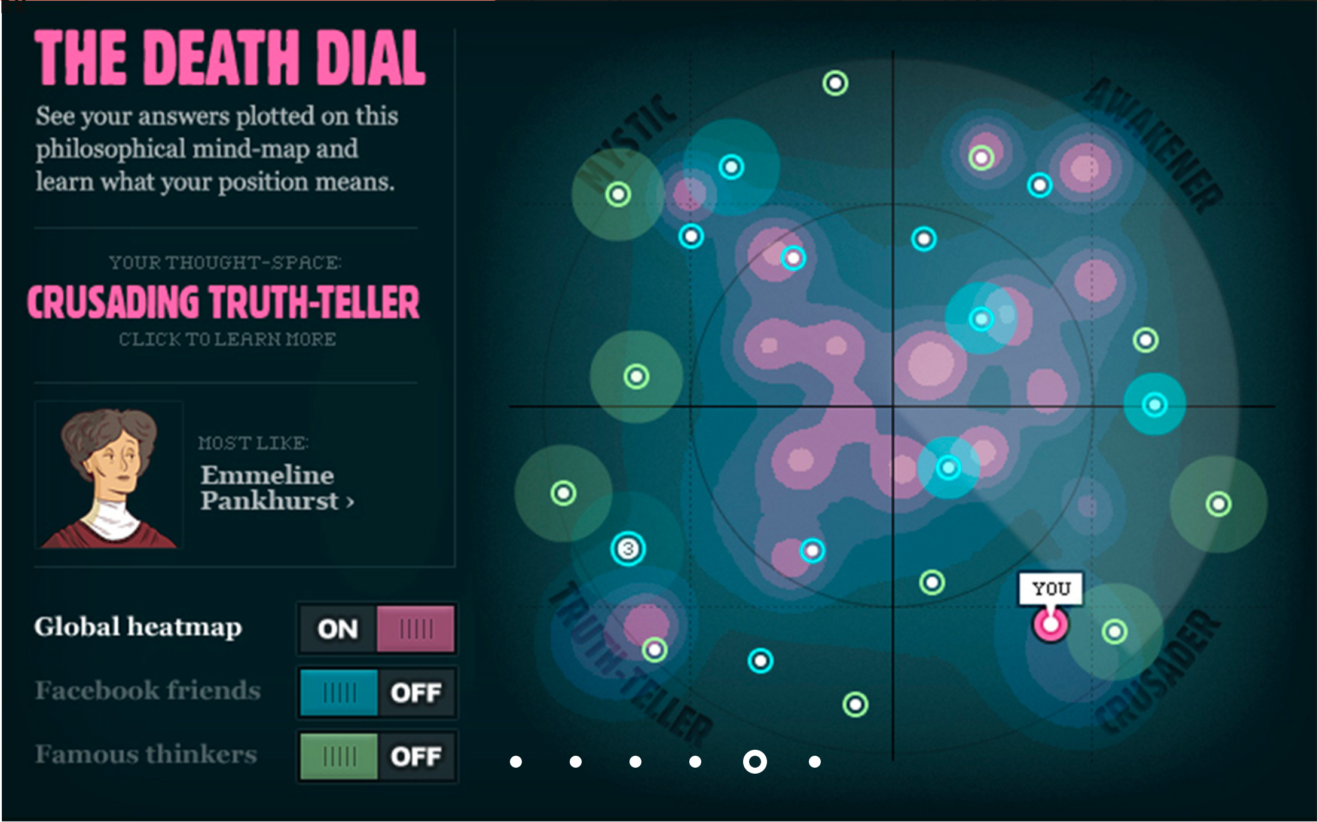
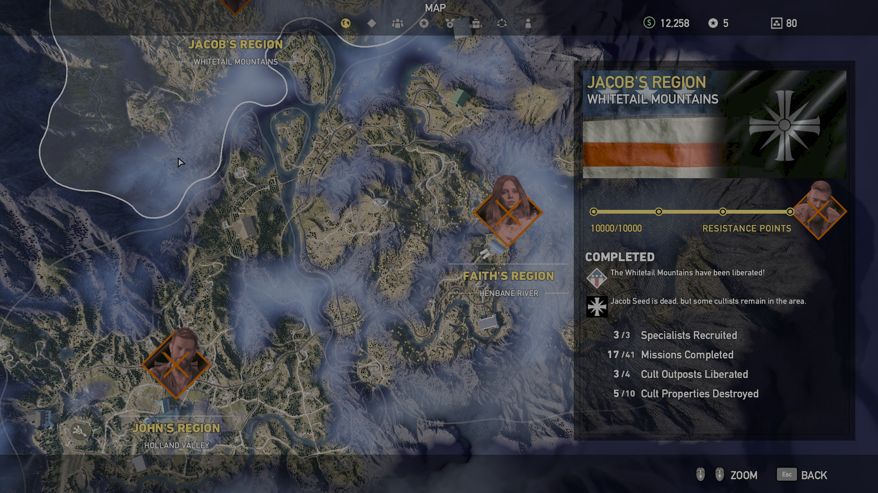
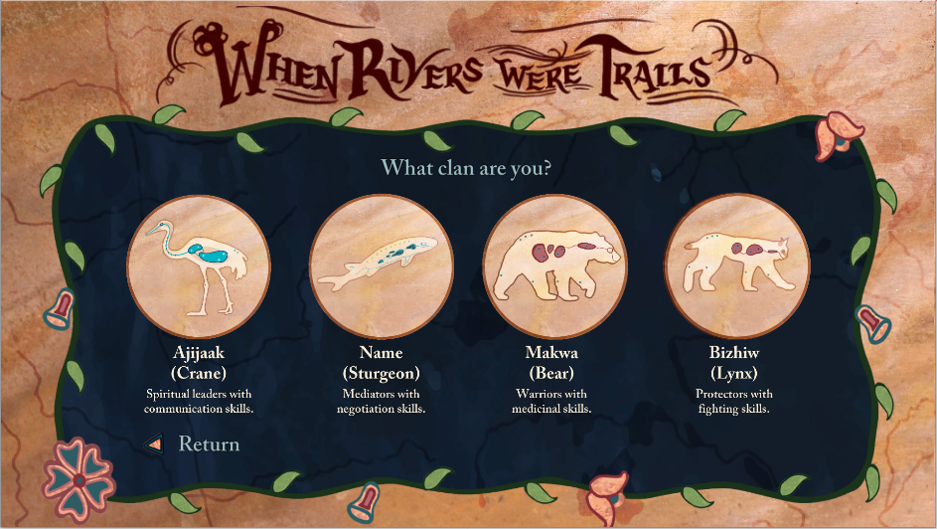
Game Design: Research
We looked at many successful games for inspiration – including, but not limited to
The Game of Life from
2018 produced by Hasboro and developed by Marmalade Game Studio taught us about content delivery and player engagement.
The End from 2011 developed by Preloaded inspired us to include a personality description based on player choices. It also contained exemplar player interaction with serious game content.
Far Cry 5 from 2018 produced by Ubisoft and developed by Ubisoft Montreal provided inspiration for a pseudo open-world with a linear story line through map interactions.
When Rivers Were Trails from 2019 by Nichlas Emmons et al. made us consider including different player archetypes and path selection.

Slide 5
Game Design: Archetype
The Academically Focused Student
Came to ASC for Academic reasons, likely Education Major
Probably lives Off-Campus
Not involved with Greek Life or SGA
Not likely to attend most activist events, but maybe a march
Maintains good relationship with Faculty

Slide 6
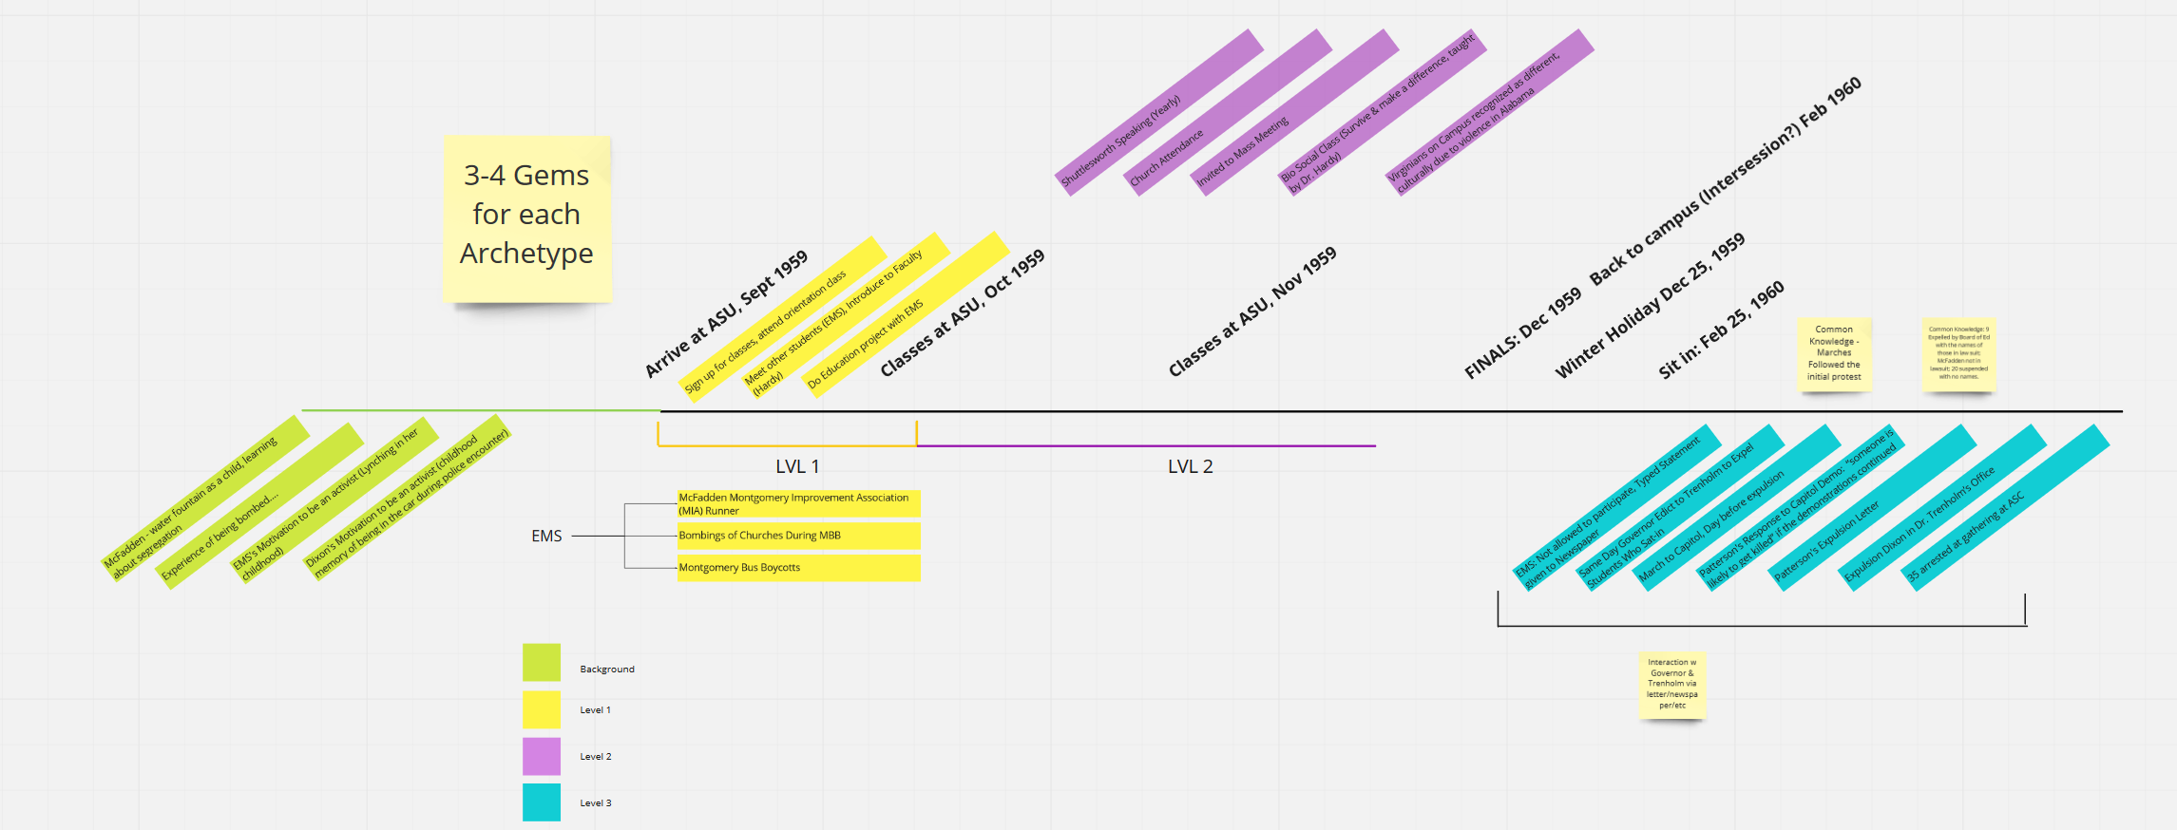
Game Design: Research
Unlike Student Leader and Student Activist, unlikely to be proactive in activism
Interact with activism indirectly through schoolwork, and relationships (EMS)

Slide 7
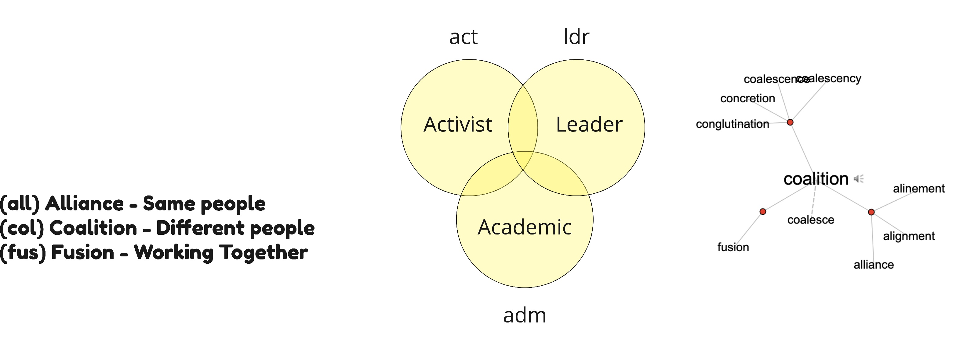
Game Design: Research
Utilizing a point system has many benefits
Meters and numbers are a familiar and attractive game mechanic
Future designers can add quests that fit in game without rewriting story
More ways to roleplay

Slide 8
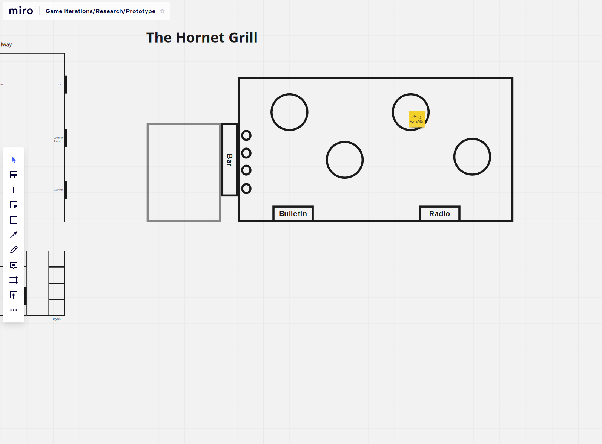
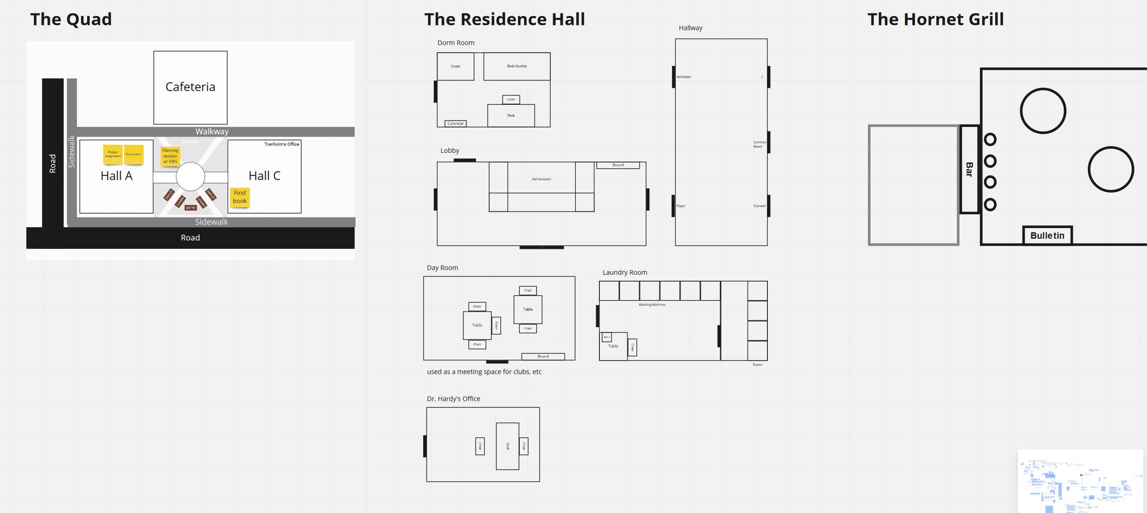
Game Design: Research
Interactions with Historical Content (Gems) will mostly consist of
Conversations and interactions with friends,
Classwork or helping faculty,
Unavoidable incidents (large-scale marches, hate speech, targeted attacks)

Slide 9
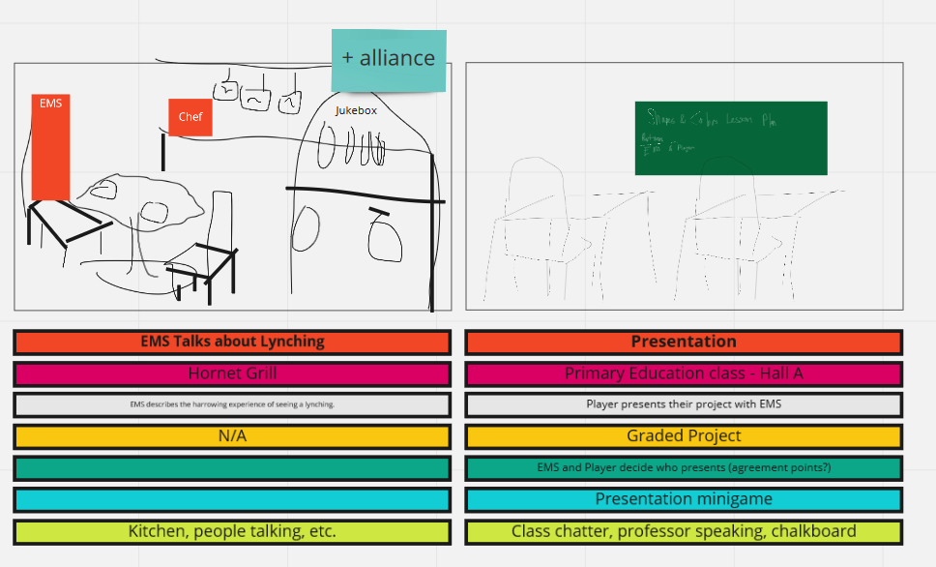
Game Design: Research

Slide 10
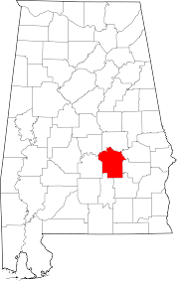
Game Design: Research + Next Steps
The design of this game will continue in the Fall Semester of 2020.
Digital, playable prototype
Completion of game map (beyond key locations)
Development of minigames (like classes in Bully)

Slide 11
Game Design: References
Game of Life. Steam. 2018.
The End. Preloaded. 2011.
Far Cry 5. Ubisoft Montreal. 2018.
When Rivers Were Trails. Itch.io. 2019.

